Slide 1
Data Transformation
Dplyr and the tidyverse

Slide 2
Workshop Objective

Slide 3
Data transformation / Manipulation
Remove unused and repeated columns
Change data types
Handle missing data
Remove string formatting and non-alphanumeric characters
Convert categorical data to numerical
Convert timestamps
Notes:
https://www.datanami.com/2019/11/08/why-you-need-data-transformation-in-machine-learning/

Slide 4
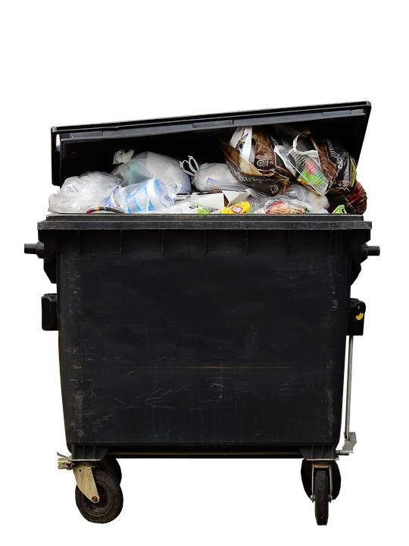

Garbage in , Garbage out

Slide 5
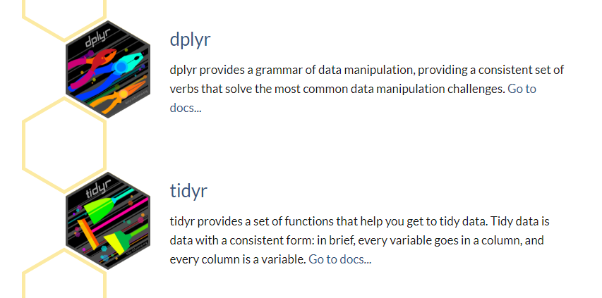
Tidyverse
The tidyverse is an opinionated collection of R packages designed for data science. All packages share an underlying design philosophy, grammar, and data structures.
Notes:
https://www.tidyverse.org/packages/

Slide 6

dplyr
dplyr is a grammar of data manipulation, providing a consistent set of verbs that help you solve the most common data manipulation challenges:
mutate() adds new variables that are functions of existing variables
select() picks variables based on their names.
filter() picks cases based on their values.
summarise() reduces multiple values down to a single summary.
arrange() changes the ordering of the rows.

Slide 7
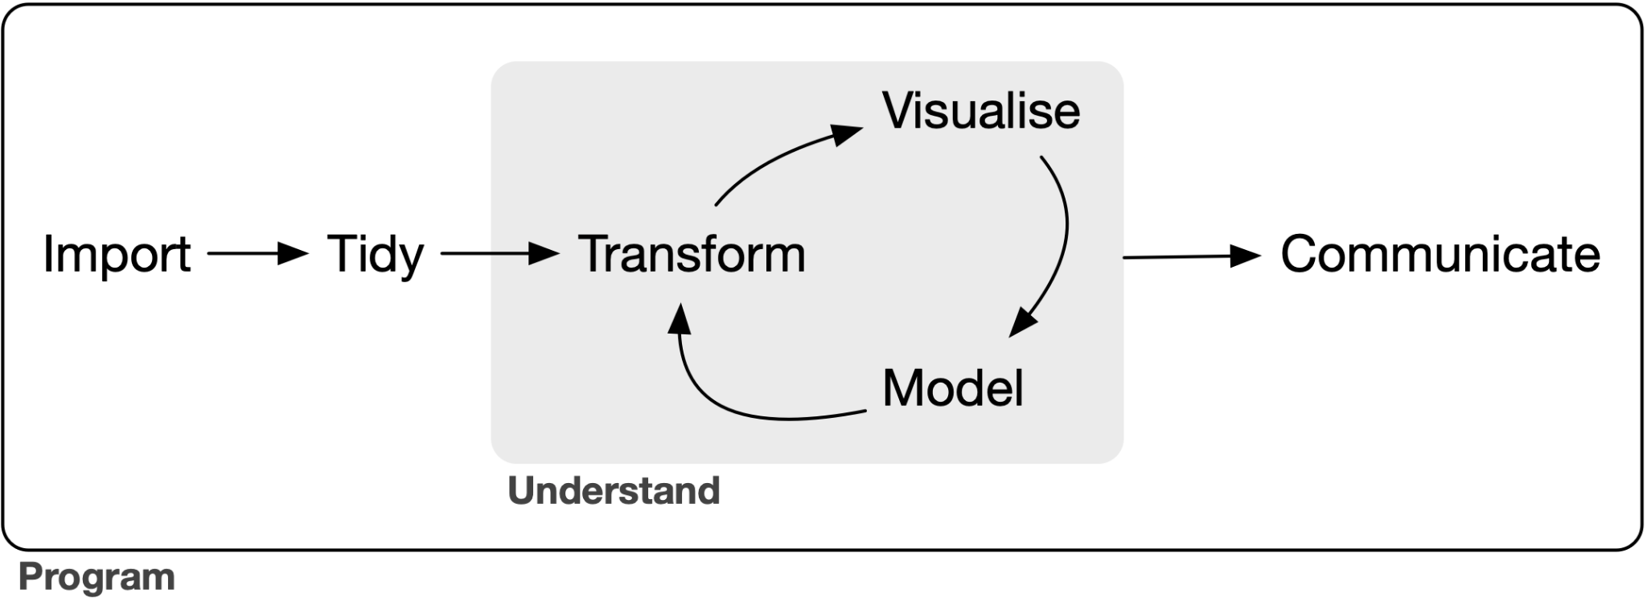
Workflow
Notes:
https://tidyverse.tidyverse.org/articles/paper.html

Slide 8
Installing packages
# The easiest way to get dplyr is to install the whole tidyverse:
install.packages("tidyverse")
# Alternatively, install just dplyr:
install.packages("dplyr")

Slide 9
Dataframe
A data frame is a table or a two-dimensional array-like structure in which each column contains values of one variable and each row contains one set of values from each column.
The column names should be non-empty.
The row names should be unique.
The data stored in a data frame can be of numeric, factor or character type.
Each column should contain same number of data items.
Notes:
https://www.tutorialspoint.com/r/r_data_frames.htm

Slide 10
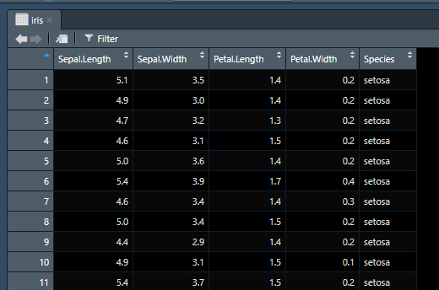
Dataframe

Slide 11
How to get your data into R?
Use integrated dataset in R (iris, Cars, mpg etc)
Import csv (import dataset from the top right corner), read.csv()
Import excel spreadsheet (import excel from the top right corner), readxl()
Download dataset from CRAN
install.packages(Gapminder)
Download dataset from Bioconductor
BiocManager::install("airway")

Slide 12
Using dplyr
library(dplyr)

Slide 13
Let’s head to R

